Slide 1
Binary Trees

Slide 2
Definitions and Properties
A binary tree is made up of a finite set of elements called nodes.
This set either is empty or consists of a node called the root together with two binary trees, called the left and right subtrees, which are disjoint from each other and from the root. (Disjoint means that they have no nodes in common.)
The roots of these subtrees are children of the root.
There is an edge from a node to each of its children, and a node is said to be the parent of its children.

Slide 3
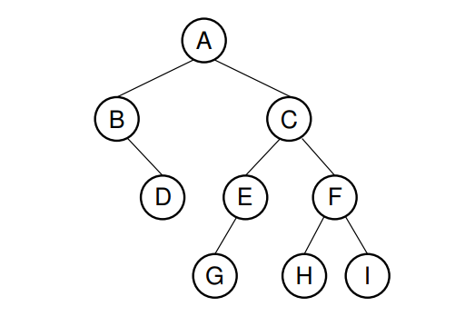
A binary tree.
Node A is the root.
Nodes B and C are A’s children.
Nodes B and D together form a subtree.
Node B has 2 children : Its left child ( the empty tree) and its right child is D.
Nodes A, C, and E are ancestors of G.
Nodes D, E, and F make up level 2 of the tree; node A is at level 0.
The edges from A to C to E to G form a path of length 3.
Nodes D, G, H, and I are leaves.
Nodes A, B, C, E, and F are internal nodes.
The depth of I is 3; Number of edges in path from root to that node(I).
The height of this tree is 4.

Slide 4
All nodes in the tree are descendants of the root of the tree, while the root is the ancestor of all nodes.
The depth of a node M in the tree is the length of the path from the root of the tree to M.
The height of a tree is one more than the depth of the deepest node in the tree.
All nodes of depth d are at level d in the tree.
The root is the only node at level 0, and its depth is 0.
A leaf node is any node that has two empty children.
An internal node is any node that has at least one non-empty child.

Slide 5
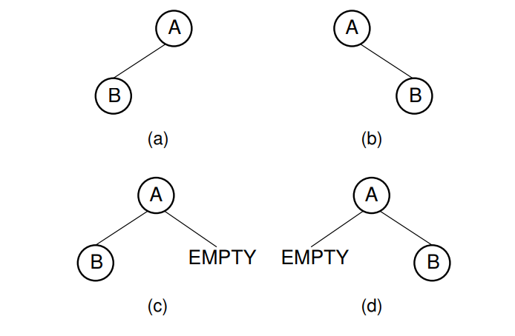
Two different binary trees.
A binary tree whose root has a nonempty left child.
(b) A binary tree whose root has a non-empty right child.
(c) The binary tree of (a) with the missing right child made explicit.
(d) The binary tree of (b) with the missing left child made explicit.

Slide 6
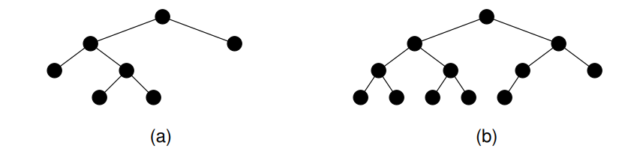
Examples of full and complete binary trees.
(a) This tree is full (but not complete).
(b) This tree is complete (but not full).

Slide 7
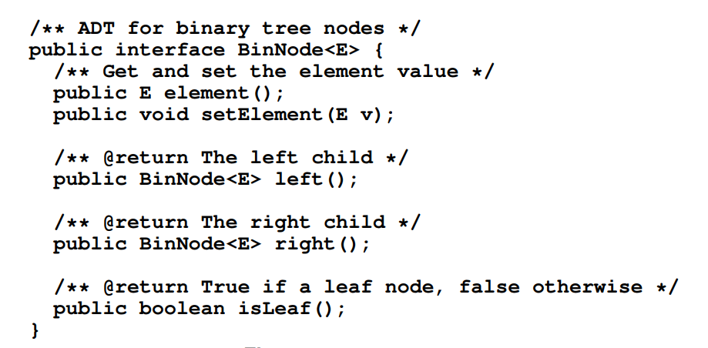
A binary tree node ADT.

Slide 8
A Binary Tree Node ADT
Just as a linked list is comprised of a collection of link objects, a tree is comprised of a collection of node objects.
ADT for binary tree nodes, called BinNode is shown in slide 7.
Class BinNode is a generic(stronger type checks at compile time) with parameter E, which is the type for the data record stored in the node.
Member functions are provided that set or return the element value, set or return a reference to the left child, set or return a reference to the right child, or indicate whether the node is a leaf.

Slide 9
Binary Tree Traversals
Any process for visiting all of the nodes in some order is called a traversal.
Any traversal that lists every node in the tree exactly once is called an enumeration of the tree’s nodes.
Some applications do not require that the nodes be visited in any particular order as long as each node is visited precisely once.
For other applications, nodes must be visited in an order that preserves some relationship.
For example, we might wish to make sure that we visit any given node before we visit its children. This is called a preorder traversal

Slide 10
Alternatively, we might wish to visit each node only after we visit its children (and their subtrees).
For example, this would be necessary if we wish to return all nodes in the tree to free store.
We would like to delete the children of a node before deleting the node itself.
But to do that requires that the children’s children be deleted first, and so on.
This is called a postorder traversal.

Slide 11
Preorder enumeration
The preorder enumeration for the tree of this tree is ABDCEGFHI.
The first node printed is the root.
Then all nodes of the left subtree are printed (in preorder) before any node of the right subtree.

Slide 12
Postorder enumeration
The postorder enumeration for this tree is DBGEHIFCA.

Slide 13
Inorder Traversal
An inorder traversal first visits the left child (including its entire subtree), then visits the node, and finally visits the right child (including its entire subtree).
Example:
The inorder enumeration for this tree is BDAGECHFI.

Slide 14
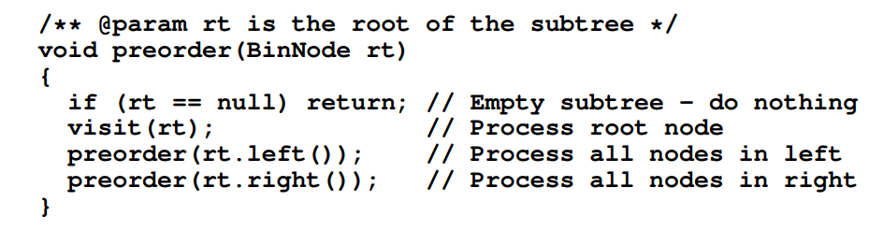
Pseudocode: Preorder
Function preorder first checks that the tree is not empty (if it is, then the traversal is done and preorder simply returns). Otherwise, preorder makes a call to visit, which processes the root node (i.e., prints the value or performs whatever computation as required by the application).
Function preorder is then called recursively on the left subtree, which will visit all nodes in that subtree.
Finally, preorder is called on the right subtree, visiting all nodes in the right subtree.
Postorder and inorder traversals are similar.
They simply change the order in which the node and its children are visited, as appropriate.

Slide 15
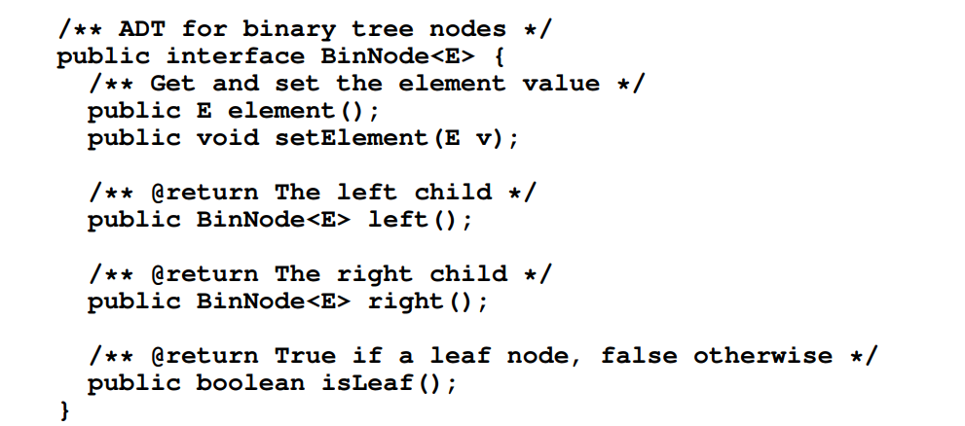
A Binary Tree Node ADT

Slide 16
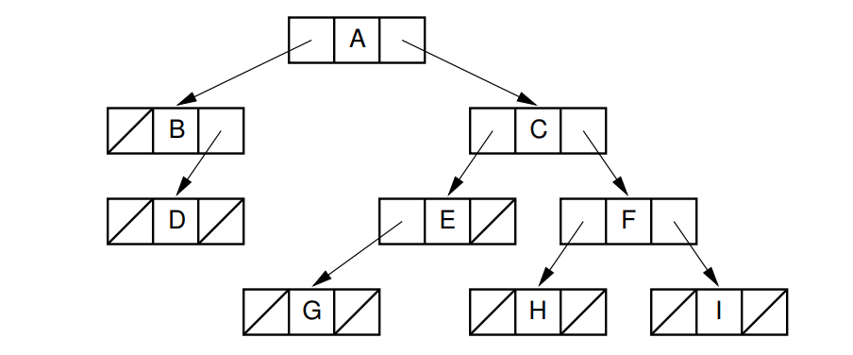
Illustration of a typical pointer-based binary tree implementation, where each node stores two child pointers and a value.

Slide 17
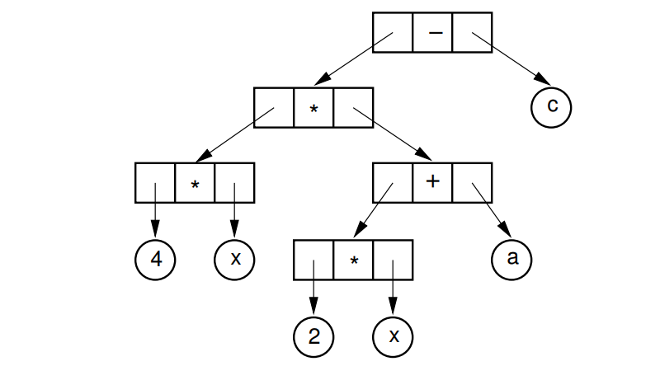
Ex: An expression tree for 4x(2x + a) − c

Slide 18
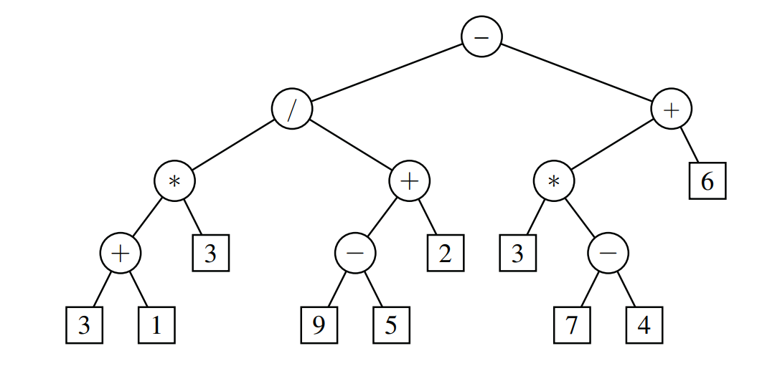
A binary tree representing an arithmetic expression.
This tree represents the expression
((((3+1) ∗ 3)/((9−5)+2))−((3 ∗ (7−4))+6)).

Slide 19
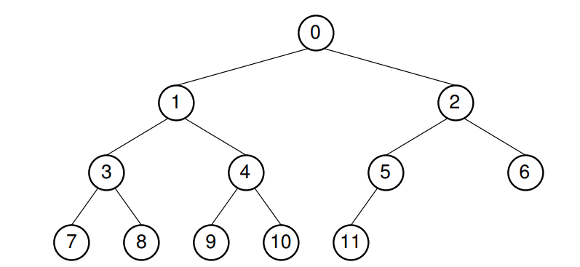
A complete binary tree and its array implementation. Example: The complete binary tree with twelve nodes. Each node has been labeled with its position in the tree.

Slide 20
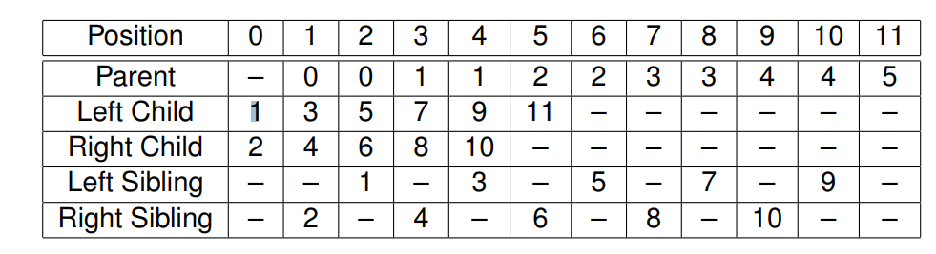
The positions for the relatives of each node. A dash indicates that the relative does not exist.
An array can store the tree’s data values efficiently, placing each data value in the array position corresponding to that node’s position within the tree.

Slide 21
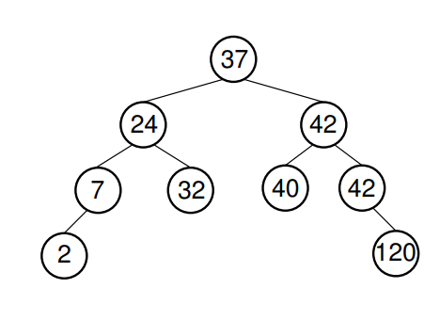
Binary Search Trees
They are binary trees, so each node has 0, 1, or 2 children
Each node stores a key
Keys are fully ordered (can compare keys using the "less than" operation)
A BST is a binary tree that conforms to the following condition, known as the Binary Search Tree Property:
All nodes stored in the left subtree of a node whose key value is K have key values less than K.
All nodes stored in the right subtree of a node whose key value is K have key values greater than or equal to K.

Slide 22
BST: Search
Searching a key To search a given key in Binary Search Tree, we first compare it with root, if the key is present at root, we return root. If key is greater than root’s key, we recur for right subtree of root node. Otherwise we recur for left subtree.
// A utility function to search a given key in BST
public Node search(Node root, int key)
{
// Base Cases: root is null or key is present at root
if (root==null || root.key==key)
return root;
// val is greater than root's key
if (root.key > key)
return search(root.left, key);
// val is less than root's key
return search(root.right, key);
}

Slide 23
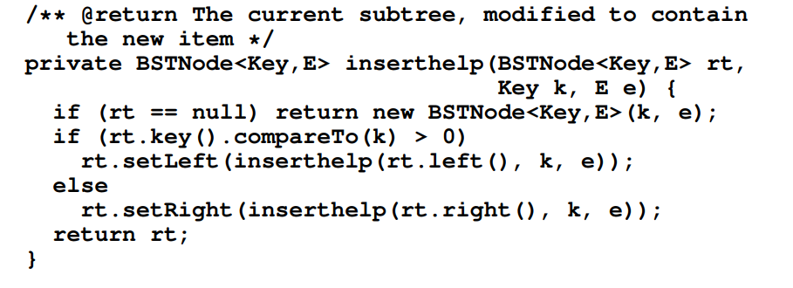
BST: Insertion

Slide 24
Insertion of a key
A new key is always inserted at leaf. We start searching a key from root till we hit a leaf node. Once a leaf node is found, the new node is added as a child of the leaf node.
100 100
/ \ Insert 40 / \
20 500 ---------> 20 500
/ \ / \
10 30 10 30
\
40

Slide 25
BST: Deletion
1) Node to be deleted is leaf: Simply remove from the tree.
50 50
/ \ delete(20) / \
30 70 ---------> 30 70
/ \ / \ \ / \
20 40 60 80 40 60 80
2) Node to be deleted has only one child: Copy the child to the node and delete the child
50 50
/ \ delete(30) / \
30 70 ---------> 40 70
\ / \ / \
40 60 80 60 80

Slide 26
3) Node to be deleted has two children: Find in-order successor of the node. Copy contents of the in-order successor to the node and delete the inorder successor.
Note: in-order predecessor can also be used.
50 60
/ \ delete(50) / \
40 70 ---------> 40 70
/ \ \
60 80 80
The important thing to note is, in-order successor is needed only when right child is not empty. In this particular case, in-order successor can be obtained by finding the minimum value in right child of the node. (ie; the least value from the node’s right subtree)

Slide 27
Pseudocode: delete_min
Removing a node from a BST is a bit trickier than inserting a node, but it is not complicated if all of the possible cases are considered individually.
To remove the node with the minimum key value from a subtree, first find that node by continuously moving down the left link until there is no further left link to follow. Call this node S.
To remove S, simply have the parent of S change its pointer to point to the right child of S.
We know that S has no left child (because if S did have a left child, S would not be the node with minimum key value). Thus, changing the pointer as described will maintain a BST, with S removed.

Slide 28
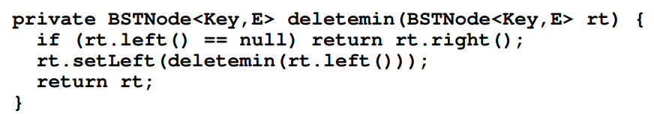
Figure(next slide) illustrates the delete_min process.
Beginning at the root node with value 10, delete_min follows the left link until there is no further left link, in this case reaching the node with value 5.
The node with value 10 is changed to point to the right child of the node containing the minimum value.
This is indicated by a dashed line.

Slide 29
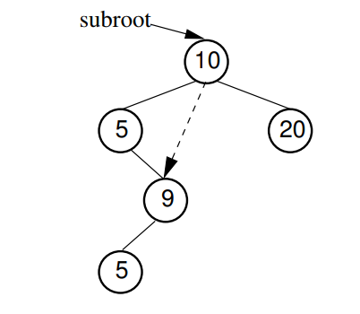
An example of deleting the node with minimum value.
In this tree, the node with minimum value, 5, is the left child of the root. Thus, the root’s left pointer is changed to point to 5’s right child.

Slide 30
Removing a node with given key value R from the BST requires that we first find R and then remove it from the tree.So, the first part of the remove operation is a search to find R.
Once R is found, there are several possibilities.
If R has no children, then R’s parent has its pointer set to null.
If R has one child, then R’s parent has its pointer set to R’s child (similar to deletemin).
The problem comes if R has two children

Slide 31
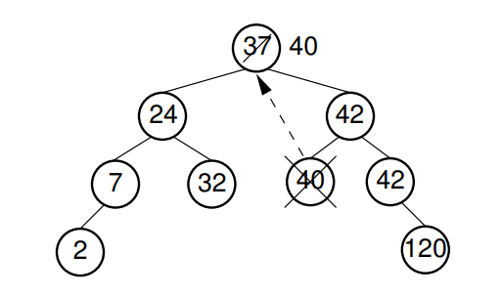
An example of removing the value 37 from the BST. (The node containing this value has two children)
We replace value 37 with the least value from the node’s right subtree, in this case 40.

Slide 32
